Slide 1
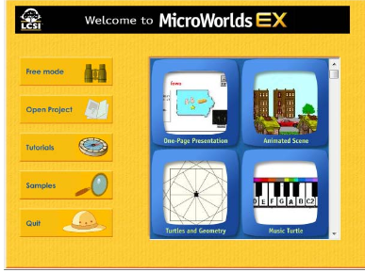
MicroWorlds
Notes:
See also handouts in notebook

Slide 2
MicroWorlds
Introduction
LOGO programming language
  For History http://en.wikipedia.org/wiki/Logo_programming_language
  http://www.computernostalgia.net/articles/logo.htm
  http://en.wikipedia.org/wiki/Turtle_graphics
  http://www.codinghorror.com/blog/archives/001026.html
  Walking Randomly http://www.walkingrandomly.com/?p=13
Notes:
See also handouts in notebook

Slide 3
Logo Language
UCB Logo http://www.cs.berkeley.edu/~bh/v1-toc2.html
Brian Harvey,
University of California, Berkeley
Three complete online Logo Programming books
  Computer Science Logo Style volume 1: Symbolic Computing 2/e Copyright (C) 1997 MIT Computer Science Logo Style
  Volume 1: Symbolic Computing
  Computer Science Logo Style volume 2: Advanced Techniques 2/e Copyright (C) 1997 MIT Computer Science Logo Style
  Volume 2: Advanced Techniques
  Computer Science Logo Style volume 3: Beyond Programming 2/e Copyright (C) 1997 MIT Computer Science Logo Style
  Volume 3: Beyond Programming
http://www.cs.berkeley.edu/~bh/

Slide 4
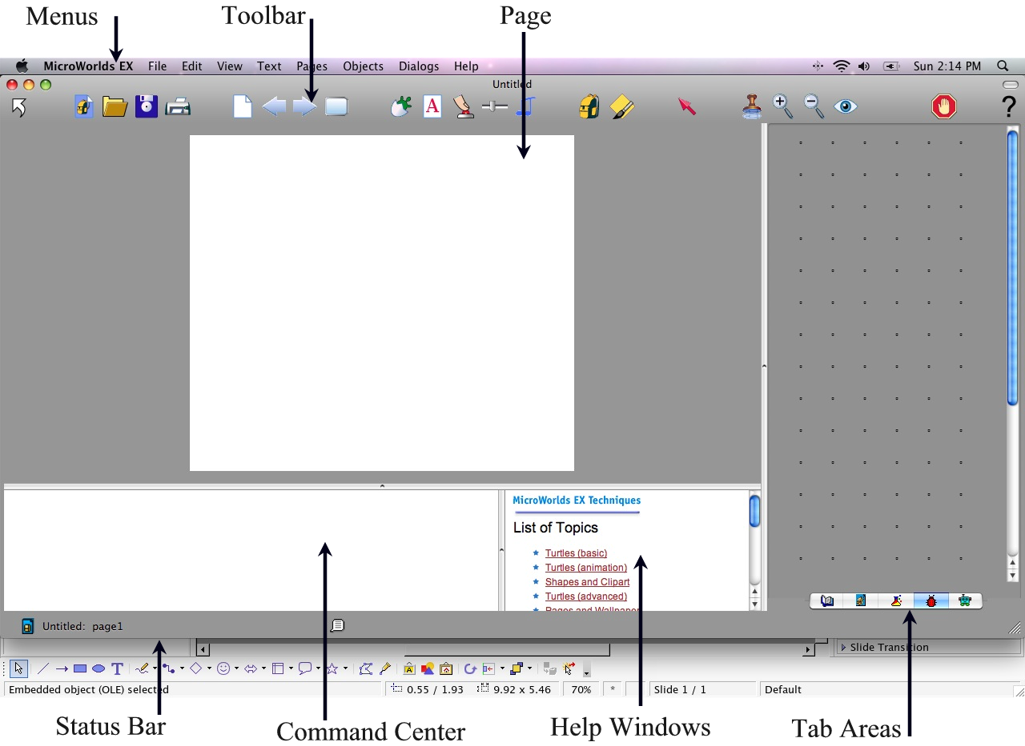
Introduction to MicroWorlds EX (MAC)

Slide 5
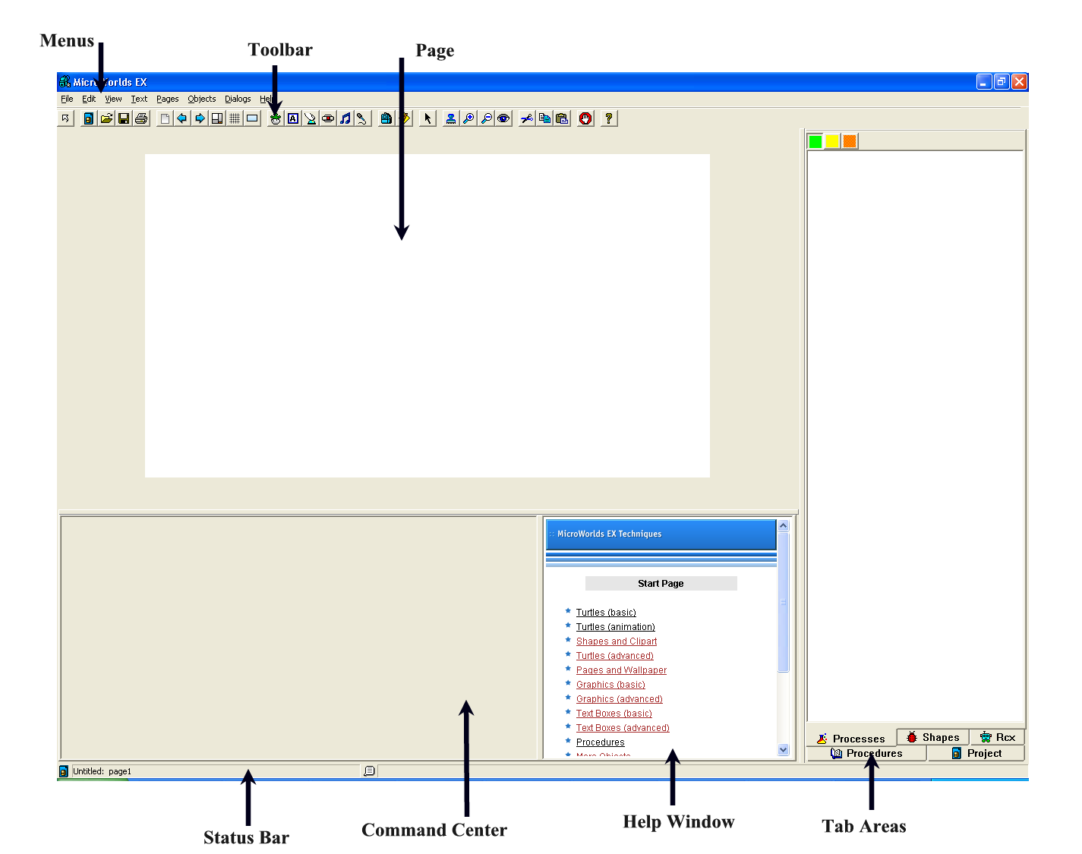
Introduction to MicroWorlds EX
(PC version)

Slide 6
Let’s Review!

Slide 7
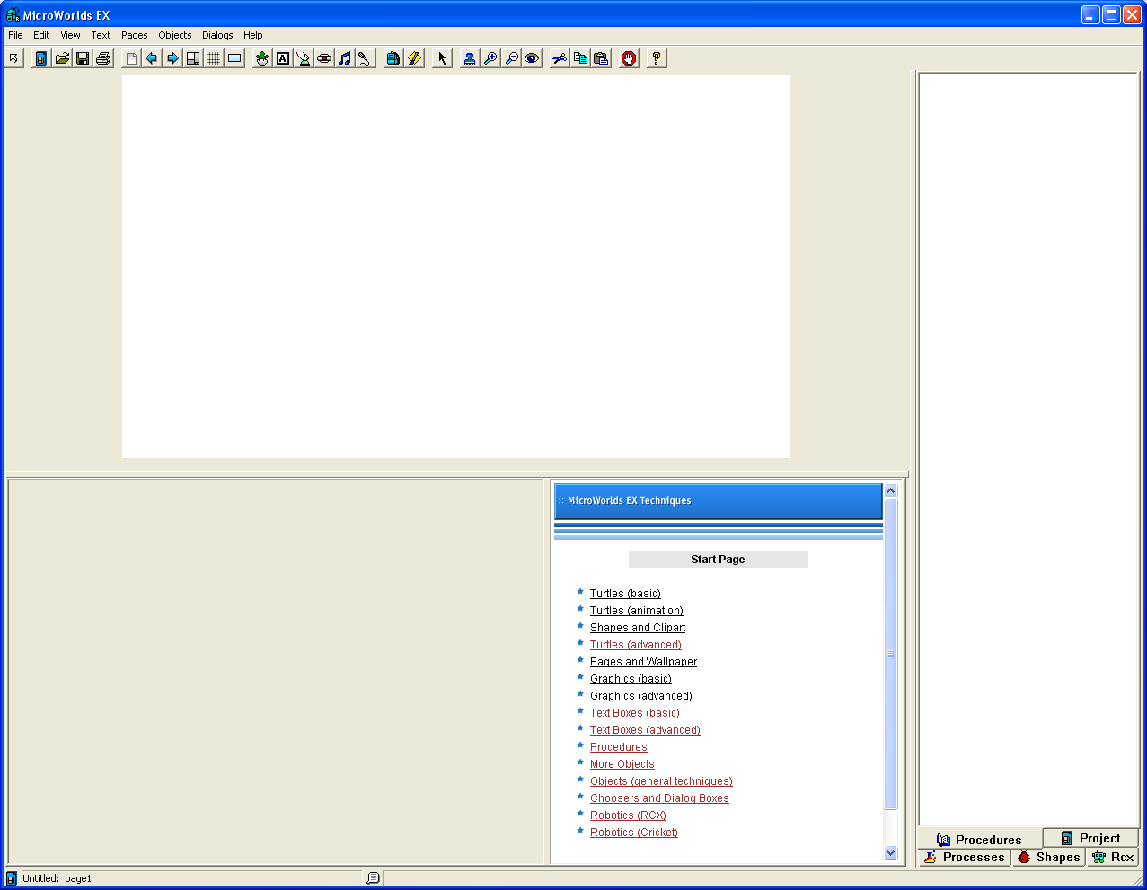
?
What’s this area?
?
What’s this area?
What’s this area?
Notes:
From left to right
Menu
Tool bar
Page
What’s this area -

Slide 8
MicroWorlds EX
Files are called Projects
Objects and text are displayed on pages
Point to:
  Menu bar
  Toolbar
  Page
  Command Center
  Status Bar
  Procedures area-What do you find here?
  Tabs

Slide 9
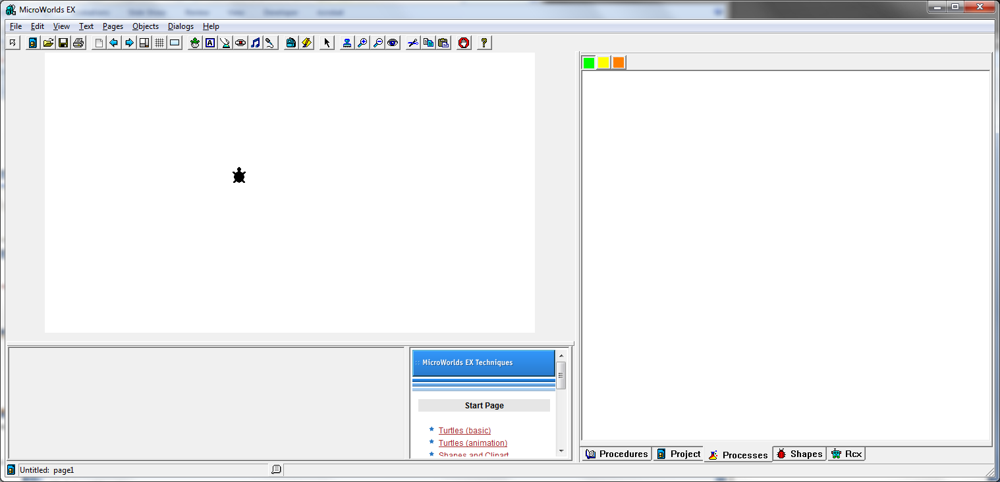
Hatch a Turtle

Slide 10
Some Basic Commands
fd
rt
bk
lt
pd
pu
repeat
setc
setpos
seth
setpensize
cg
clean
Notes:
Cg= cleans and takes turtle to 0-0 coordinates
Clean just cleans graphics w/out moving turtle
See handout –cut and paste onto index cards for students cheat sheet

Slide 11
Some Basic Commands
fd (forward)
rt (right)
bk (back)
lt (left)
pd (pen down)
pu (pen up)
repeat
setc (set color)
setpensize
cg (clear graphics)
clean
Which one of the basic programming concepts?
Notes:
Which one of the basic programming concepts? [syntax]

Slide 12

Some Basic Shapes
Hatch a “turtle”
pd
fd 50
rt 90
fd 50
rt 90
fd 50
rt 90
fd 50

Slide 13
Short Cuts
In the command center
fd 100
rt 90
fd 100
rt 90
fd 100
rt 90
fd 100
rt 90
Is the same as:
repeat 4 [fd 100 rt 90]
Which one of the basic programming concepts?
Notes:
Which one of the basic concepts? Data structures

Slide 14



Can you draw and program these?
Write commands to draw each of these shapes.
For each shape, how much does the turtle turn to draw each angle?
Notes:
MicroworldsStars.doc
MicroworldsPolygons.doc
MicroWorlds_Vocabulary.doc
to 5star
pd
repeat 5 [fd 100 rt 144
]
pu
end
to 9star
pd
repeat 9 [fd 100 rt 160
]
pu
end
360*(6/2) /7 = 154.2857
to 7star
pd
repeat 7 [fd 100 rt 154.2857]
pu
end

Slide 15
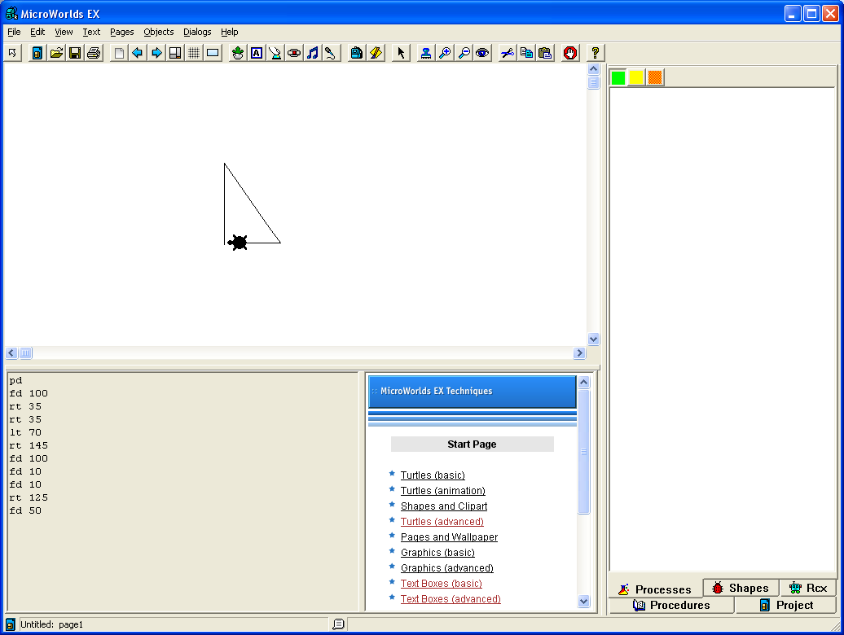
How can I get the turtle to draw a Right Angle?

Slide 16
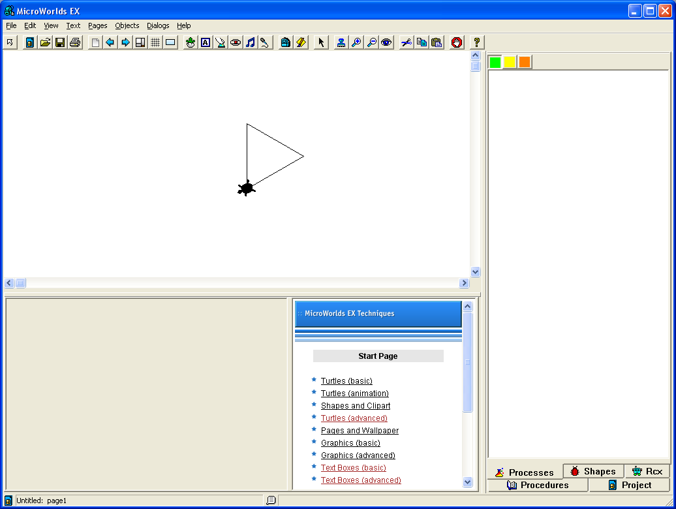
Team Challenge
Equilateral Triangle

Slide 17
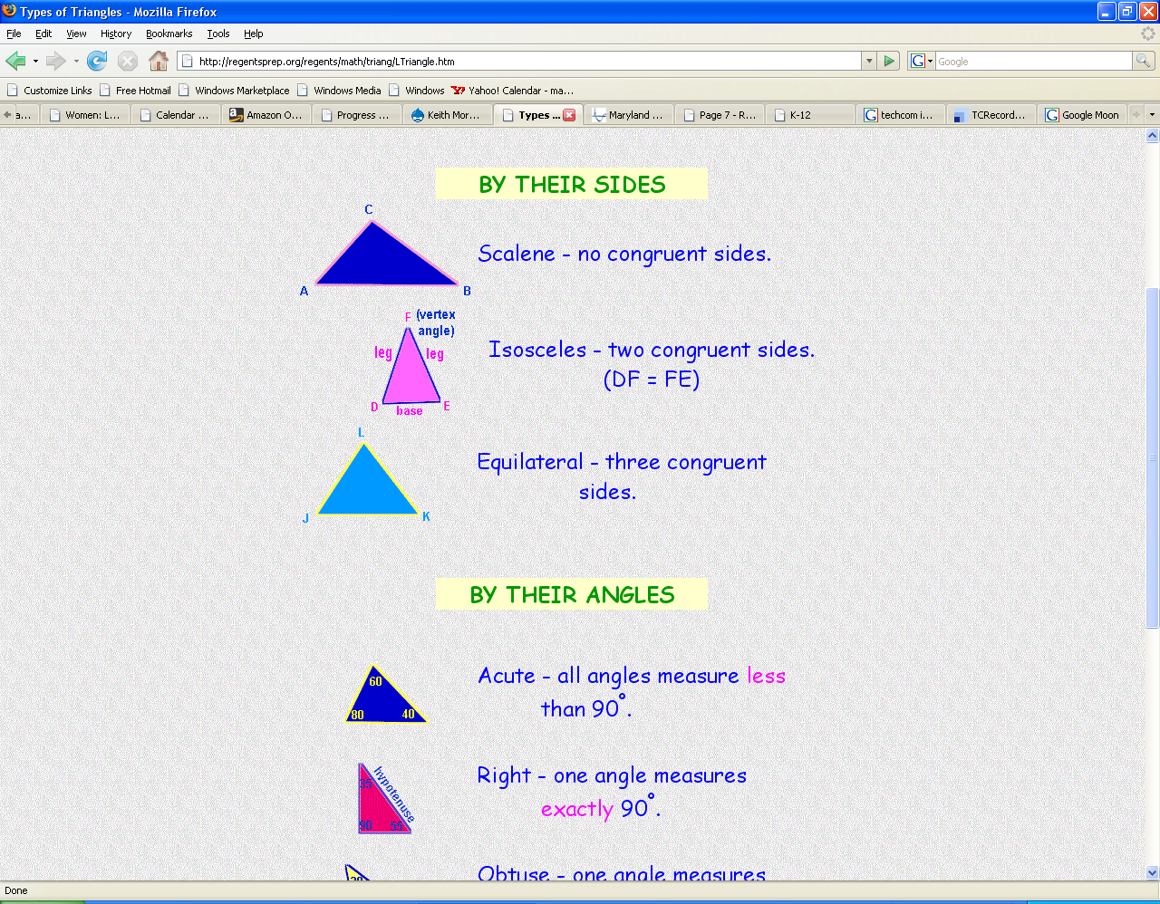
Triangles Classified in 2 Ways

Slide 18
By their Sides

Slide 19
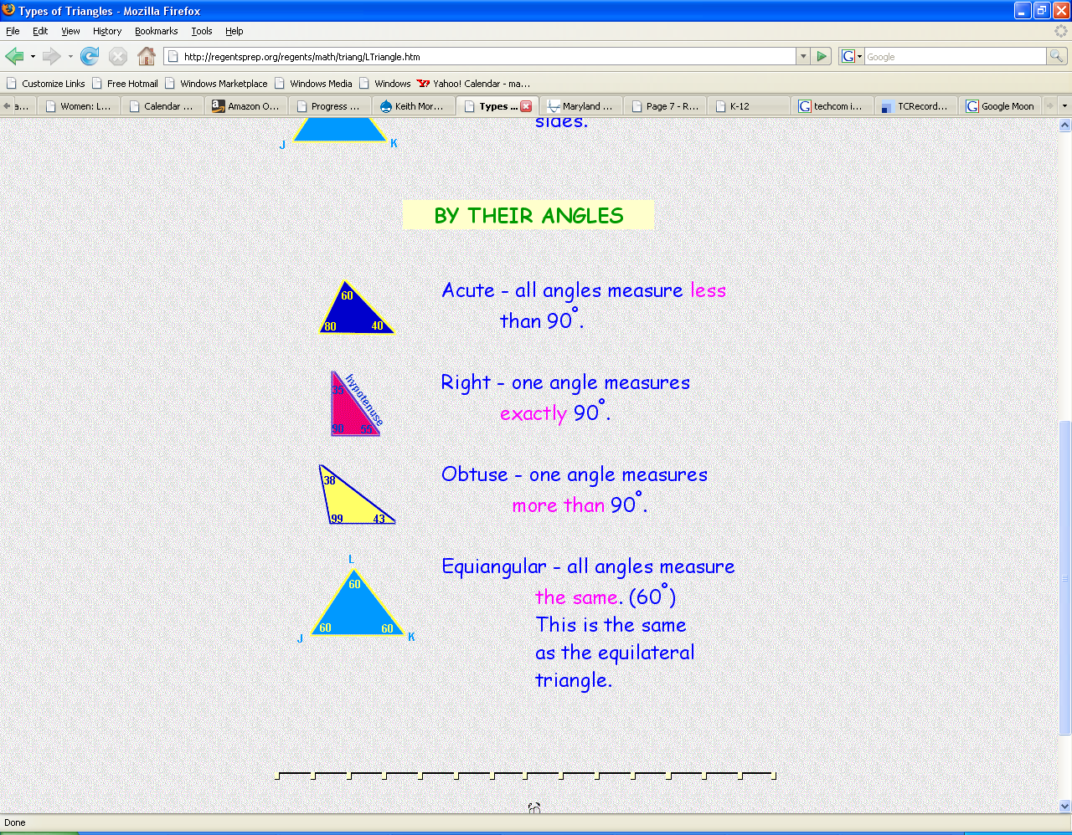
By their Angles

Slide 20
You can draw the shapes in any size, thickness, or color.
to colorsquare
setpensize 5
setc 15
repeat 4 [fd 100 rt 90]
end

Slide 21
MicroWorlds Exercise
Turtle Geometry and Teaching Turtles Words
See Handouts
Notes:
Zigzag exercise and can change color and size Teach_the_Turtle_New_Words.doc
mwnotes_asword.doc
MicroworldsTabs.doc

Slide 22
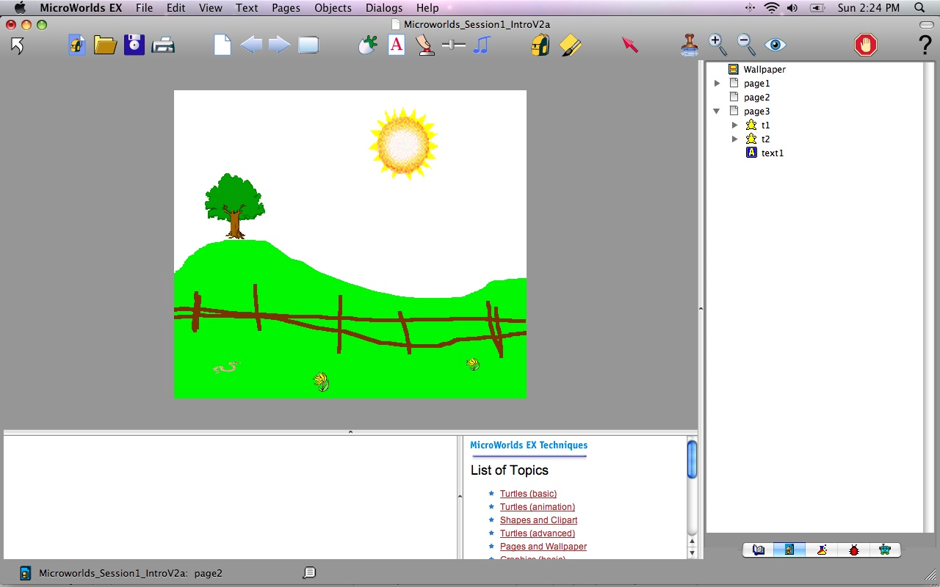
Notes:
Introduce
Drawing tools—remind that when doing fill have to touch each side otherwise “color” will “bleed” through
Introduce painting/clip art (without animation)—tree sum—flowers
Introduce animation--add boy—add turtle—move head so pointing up—add balloons on top—right click “animate”
Then introduce horse or other and animation
BREAK and have them work on their own

Slide 23
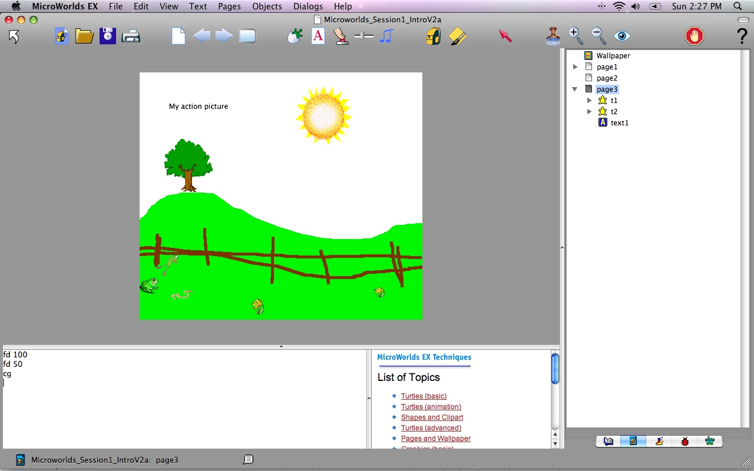
Notes:
Introduce graphics—drawing and animations

Slide 24
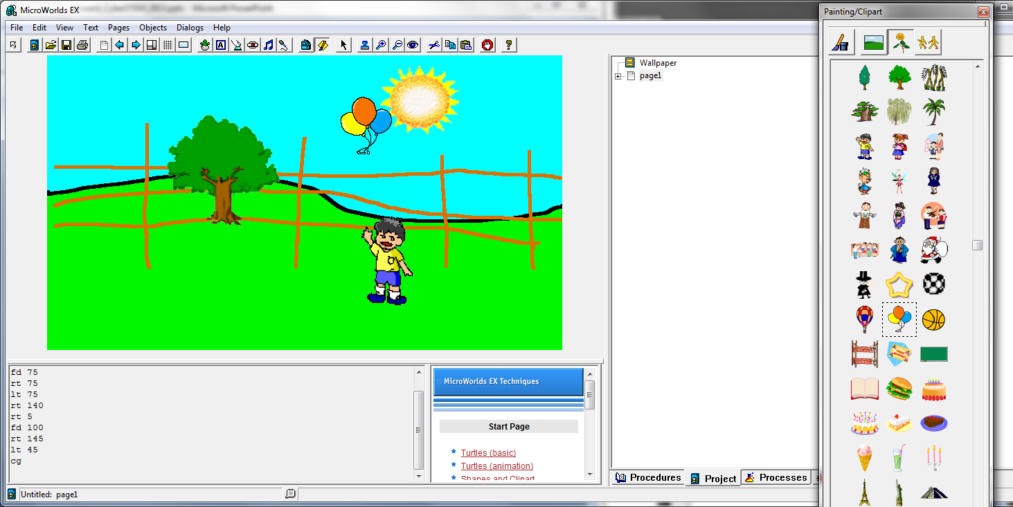
Notes:
Introduce animation--add boy—add turtle—move head so pointing up—add balloons on top—right click “animate”
Then introduce horse or other and animation options (click and hold and drag on top of turtle)
BREAK and have them work on their own

Slide 25
An Animated Story
Walk through the creation of an
Animated Story
Notes:
Create one page with animated figures

Slide 26
Class Needs More Practice?
Answering Basics
For beginning work with animation, try make a face, animate me, race cars, bouncing off walls, or growing spider.
For beginning work with a game, try obstacle course.
For beginning work with textboxes, try animated story.

Slide 27
MicroWorld Examples
Visit some of the following to see what is possible:
http://www.mathcats.com/microworlds.html MathCats Interactive Math games and activities
Tic-Tac-Toe http://www.thehunters.org/logo/
http://mia.openworldlearning.org/ Open World Learning-go to Project Folders
http://www.cattanach.org/microworlds/index.html (go to the bottom icon and click List Sites)

Slide 28
Converting to a Procedure #1
(On the Procedures Tab to the right)
to square
repeat 4 [fd 100 rt 90]
end
Once you know the commands you want to convert the command to a procedure
Notes:
“the issue becomes …….you can create page with graphics and animated figures” but it’s not much fun if you have to run around and click on each to get them to work
They also loop around the page
Also when you place in show mood there’s no way to click on
So what do we do? Convert to procedure and use items such as buttons to start the animations instead

Slide 29
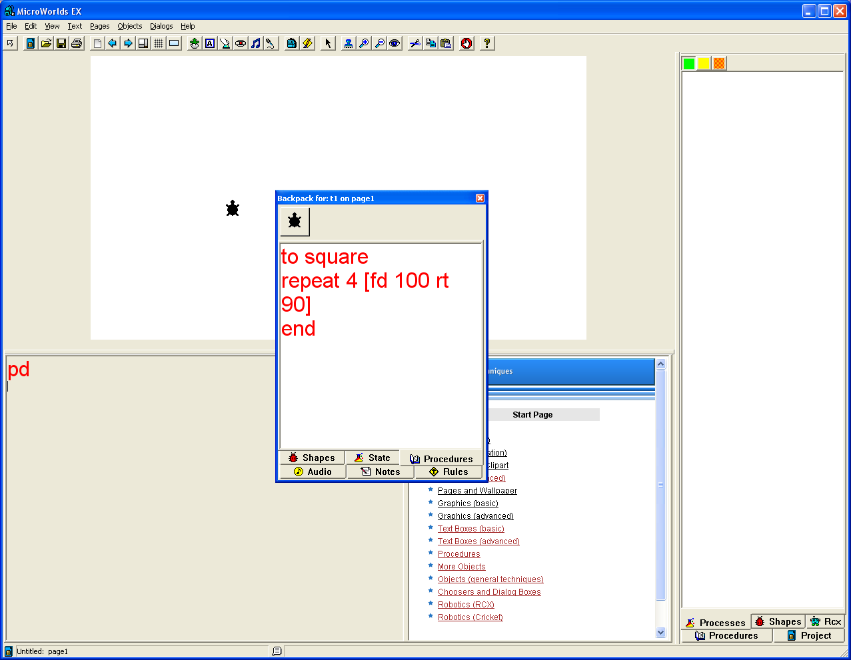
Converting to a Procedure #2
(On the Procedures Tab in the turtles backpack)
to square
repeat 4 [fd 100 rt 90]
end
Once you know the commands you want to convert the command to a procedure

Slide 30
Converting to a Procedure
(On the Procedures Tab)
to square
repeat 4 [fd 100 rt 90]
end
Test it:
Create a button
Type the procedure in command center
On the turtle (object) → edit → command
Once you know the commands you want to convert the command to a procedure

Slide 31
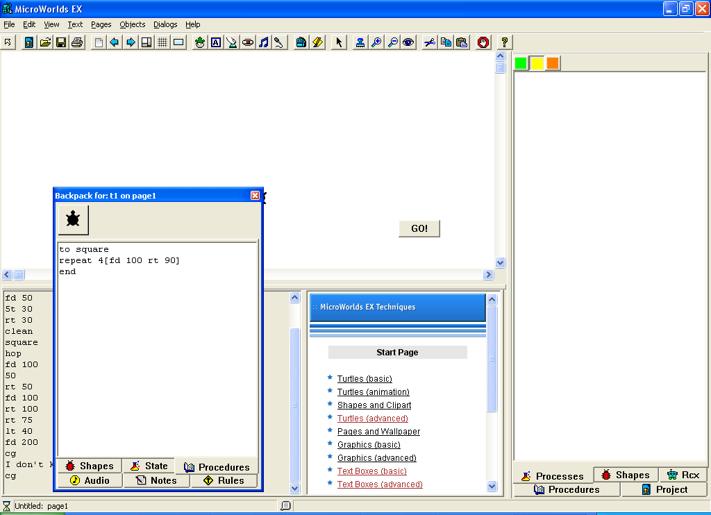
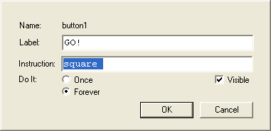
Test it:
Create a button
Type the procedure in command center
On the turtle (object) → edit → command
Notes:
Use the boy/balloon example and show how a button can be used

Slide 32
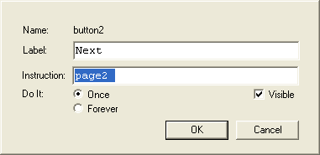
New Pages and Turning Pages
Pages
  New
Make a button
Right Click or Ctrl and then Edit
Label: This shows up on the button
Instructions: list a page you want it to go to
  page2

Slide 33
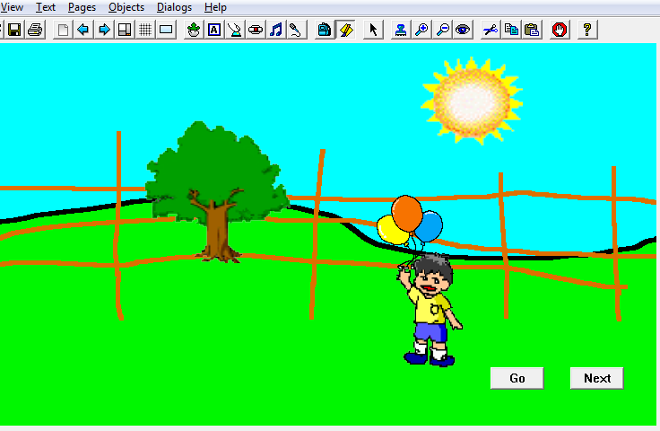
Notes:
Show how to duplicate slide
Show how the next page works
Button and page#

Slide 34
Exercise
Create a three page “story”
Use buttons to turn pages
Program your “turtles”

Slide 35
Student Examples
Show & Share

Slide 36
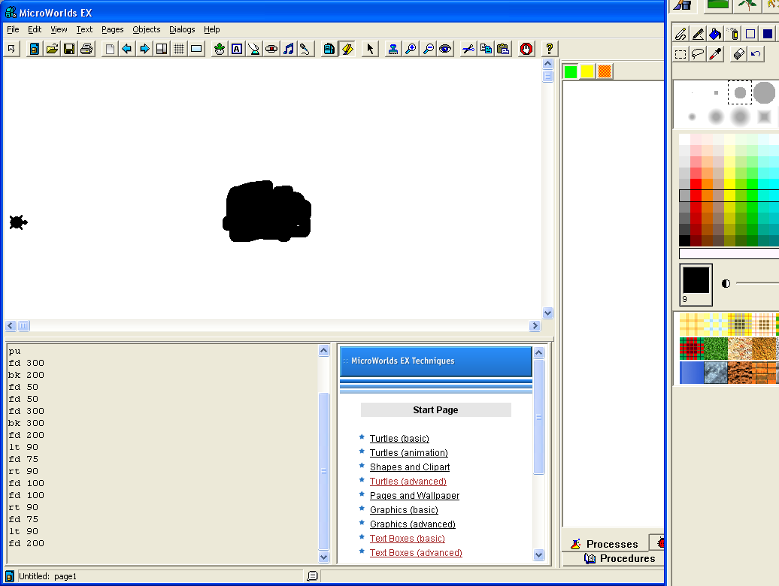
Team Challenge
How do you program a “turtle” to move forward and jump over or move around the rock?
Notes:
This will probably be day two—but is listed here as many classes move fast
STEPS
Draw a “rock”
Hatch a turtle
Move head so points towards rock
Now program the turtle to move around the rock

Slide 37
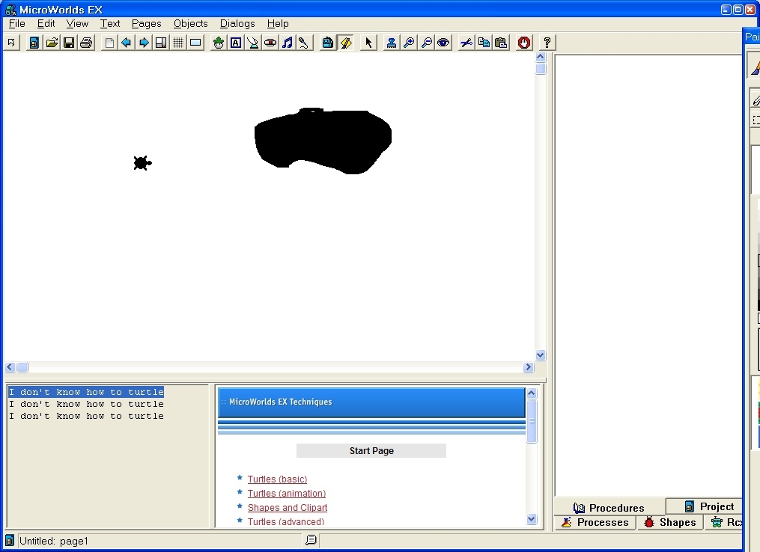
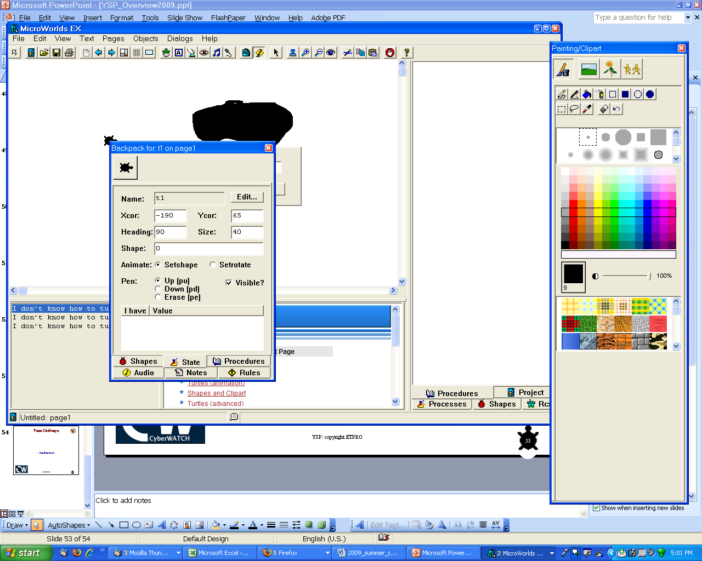
Rename the turtle from t1 to turtle
Draw a rock & hatch a turtle
Notes:
Introduce renaming t1 and naming hints—ie when you have 15 turtles you will not know t12 from t2—change name so you know what is what

Slide 38
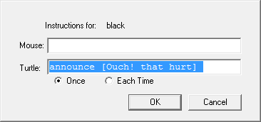
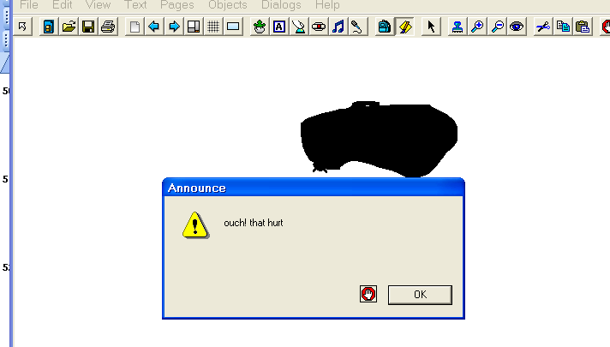
Add a pop up command for an object/color
Notes:
Introduce pop up
Announce [what ever you want announced]

Slide 39
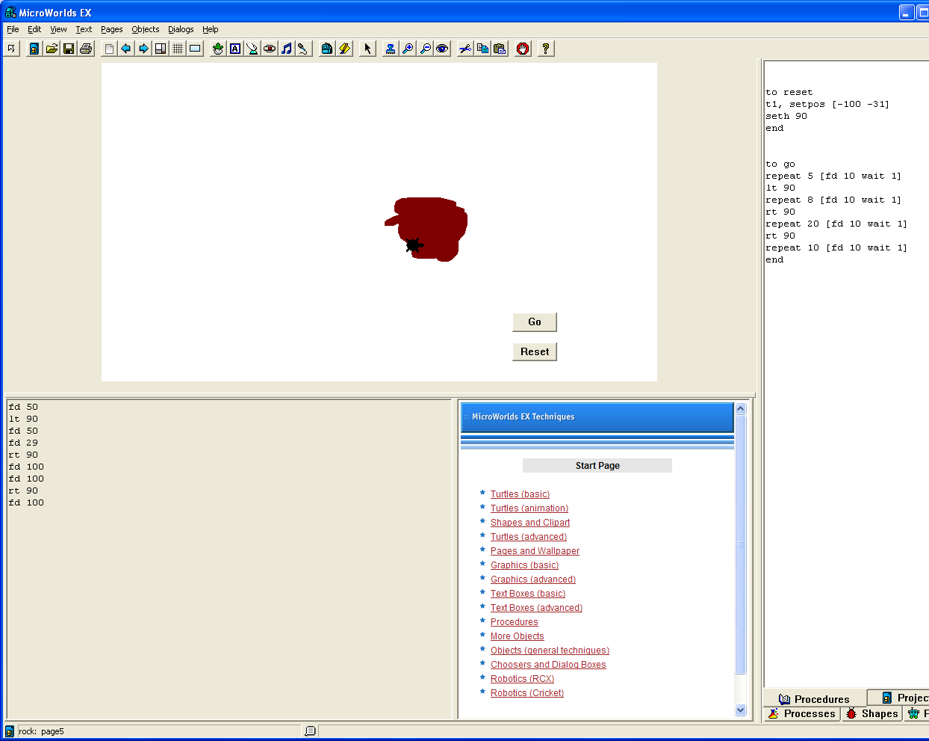
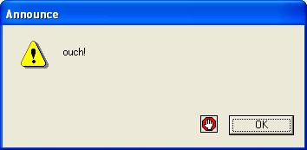
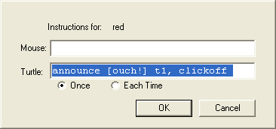
Announce

Slide 40
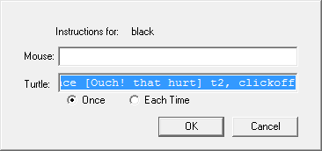
But then it keeps going?
The turtle name
, clickoff
Notes:
Announce [what you want it to announce] name of turtle, clickoff

Slide 41
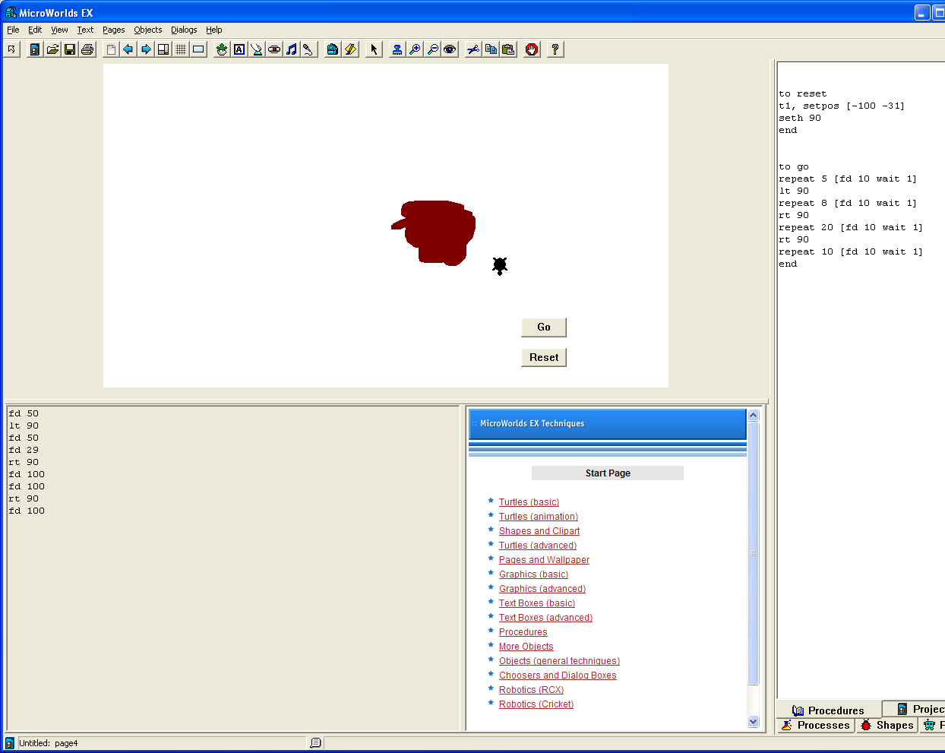
But it’s going too fast!
How to Slow it Down
Notes:
To go
Repeat 5 [fd 10 wait 1]
Ie use the wait function to help slow it down

Slide 42
Program a turtle to go around a rock…slowly
Steps
  Draw a rock
  Hatch a turtle
  Find the coordinates
    Click on turtles backpack
  Teach “reset”
    Example.
      to reset
      t1, setpos [-50 69]
      End
  Make a reset button
  Test movement in command center
  Convert to a procedure
Steps continued:
8. Use a procedure button
9. Make it move slowly with “wait” code
  Example
    to go
    repeat 5 [fd 10 wait 1]
    lt 90
    repeat 8 [fd 10 wait 1]
    rt 90
    repeat 20 [fd 10 wait 1]
    rt 90
    repeat 10 [fd 10 wait 1]
    end

Slide 43
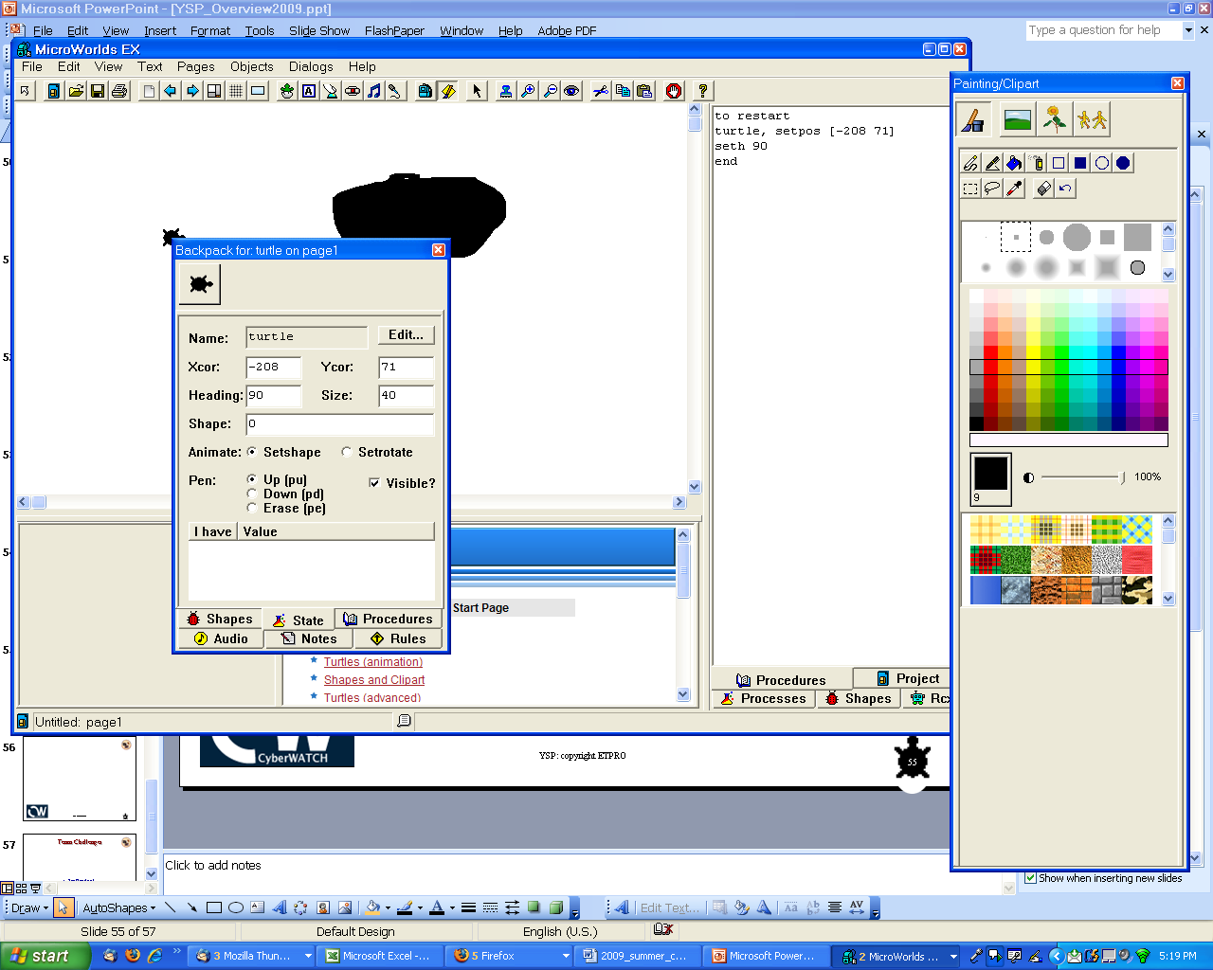
To add a reset button find the coordinates
Notes:
Let’s say it was a game and if you hit the rock you had to start from the beginning
Or you probably noticed when trying to figure out the distance it changed each time you “replaced” the turtle…why?
Because you have to reset it at the EXACT position
Introduce corrdinated—0,0 in middle –4 quadrants
Open backpack to see coordinates
Add reset button—and then with procedures explain what “rest” is
To reset
Name of turtle, setpos [x y]
Seth 90
End
For example…
to reset
t2, setpos [ -304 -128]
seth 90
End

Slide 44
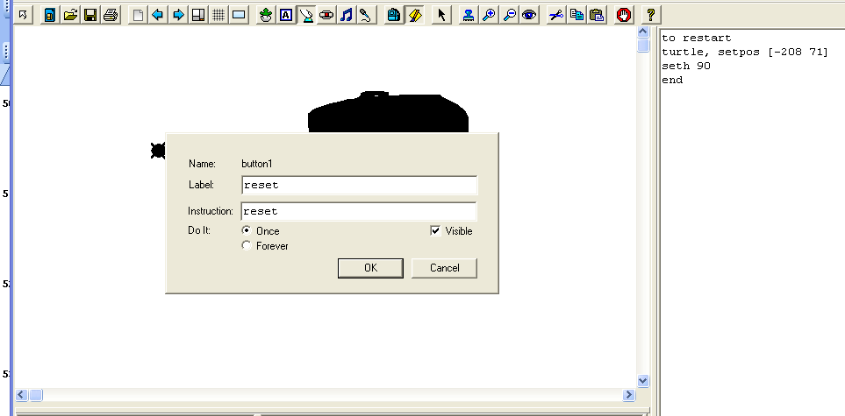
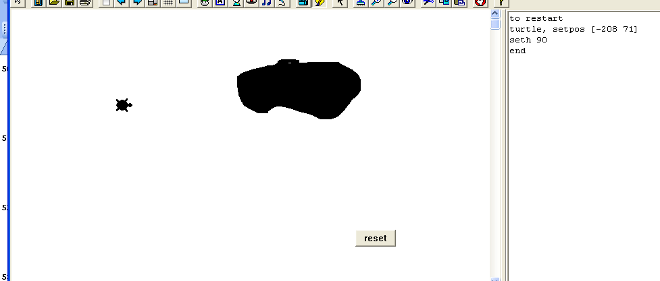
Add the button
“teach” the computer the command for “reset”

Slide 45
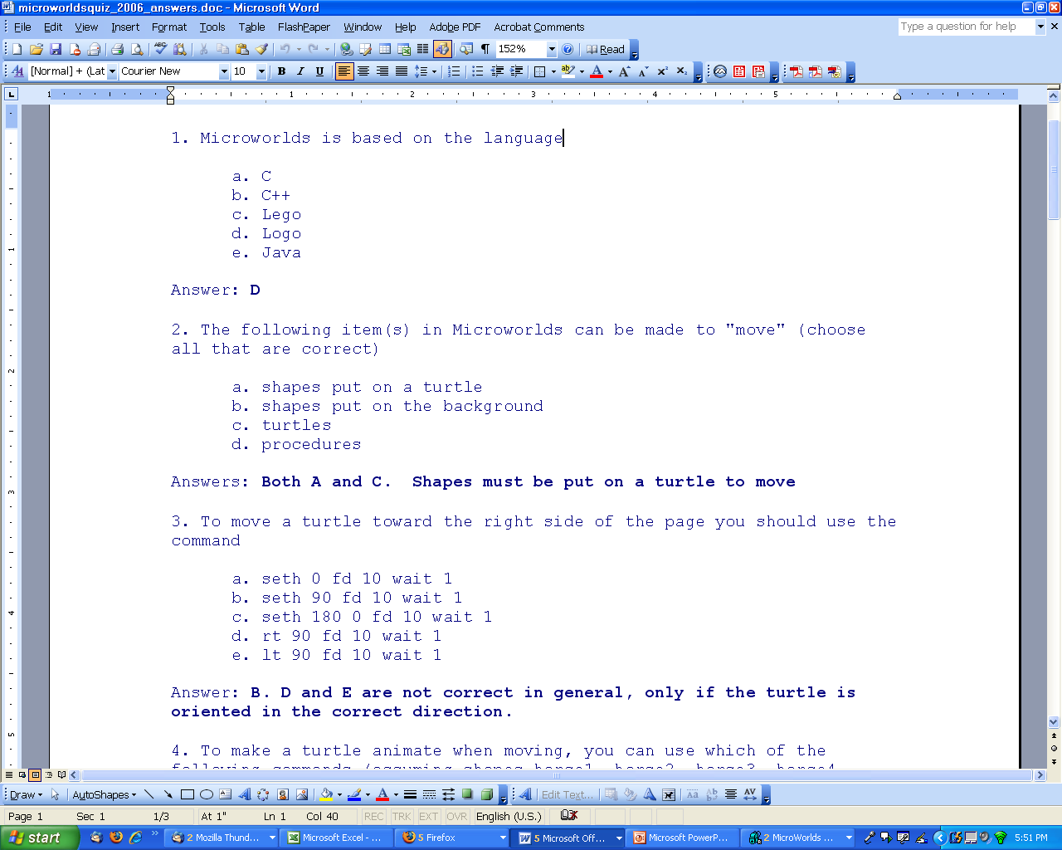
MW Quiz
XXXXX
xxx
Notes:
Logo
A and C
B you have to seth 90 first as by default the turtle points straight up

Slide 46
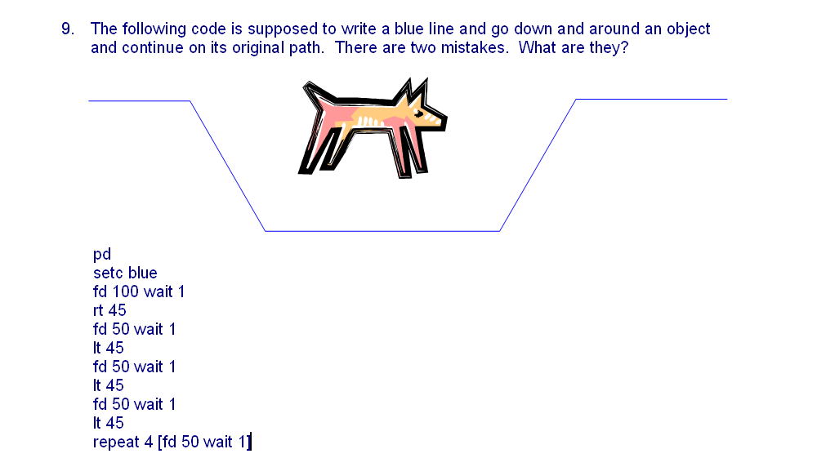
Answers: Need a double quotation before blue, and last lt should be rt.
Notes:
Answers: Need a double quotation before blue, and last lt should be rt.

Slide 47
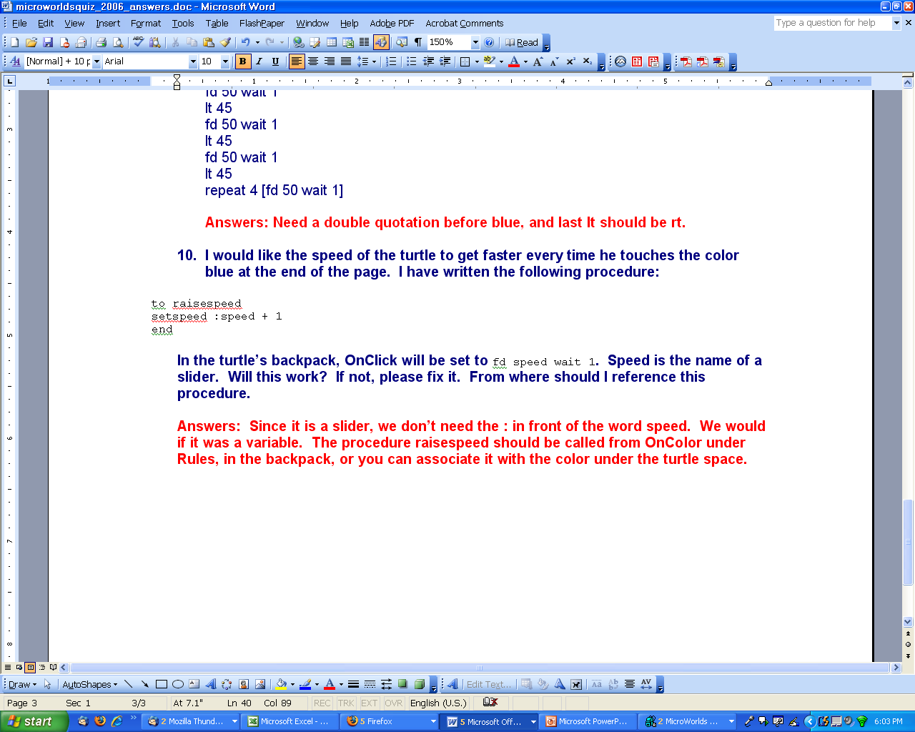
Answers: Since it is a slider, we don’t need the : in front of the word speed. We would if it was a variable. The procedure raisespeed should be called from OnColor under Rules, in the backpack, or you can associate it with the color under the turtle space.
Notes:
Answers: Since it is a slider, we don’t need the : in front of the word speed. We would if it was a variable. The procedure raisespeed should be called from OnColor under Rules, in the backpack, or you can associate it with the color under the turtle space.

Slide 48
What does Logo language have to do with Cybersecurity?
What does programming in MicroWorlds have to do with Cybersecurity?

Slide 49
We are getting lots of machines with hits on this, particularly student laptops on the wireless network. I managed to track down this reference: http://www.threatexpert.com/report.aspx?md5=c3c72f77f53bb50deec784c89f7c8f62
does anyone know any m ore about this threat? Russell.
If I had to guess, it's a password stealer directed at online games like World of Warcraft, EVE Online, Star Wars Galaxies, or Lord of the Rings Online. Hackers in China have figured out how to take control of these accounts, steal all the ingame money, and/or use the accounts in macro programs to farm in-game money which they sell for real life cash through any number of websites. The Chinese hackers make big money at it and the victim accounts eventually get banned for violating the game's EULA.
Charles XX XXXXX
Senior Security Analyst
University of Tennessee Information Security Office Martin Campus

Slide 50
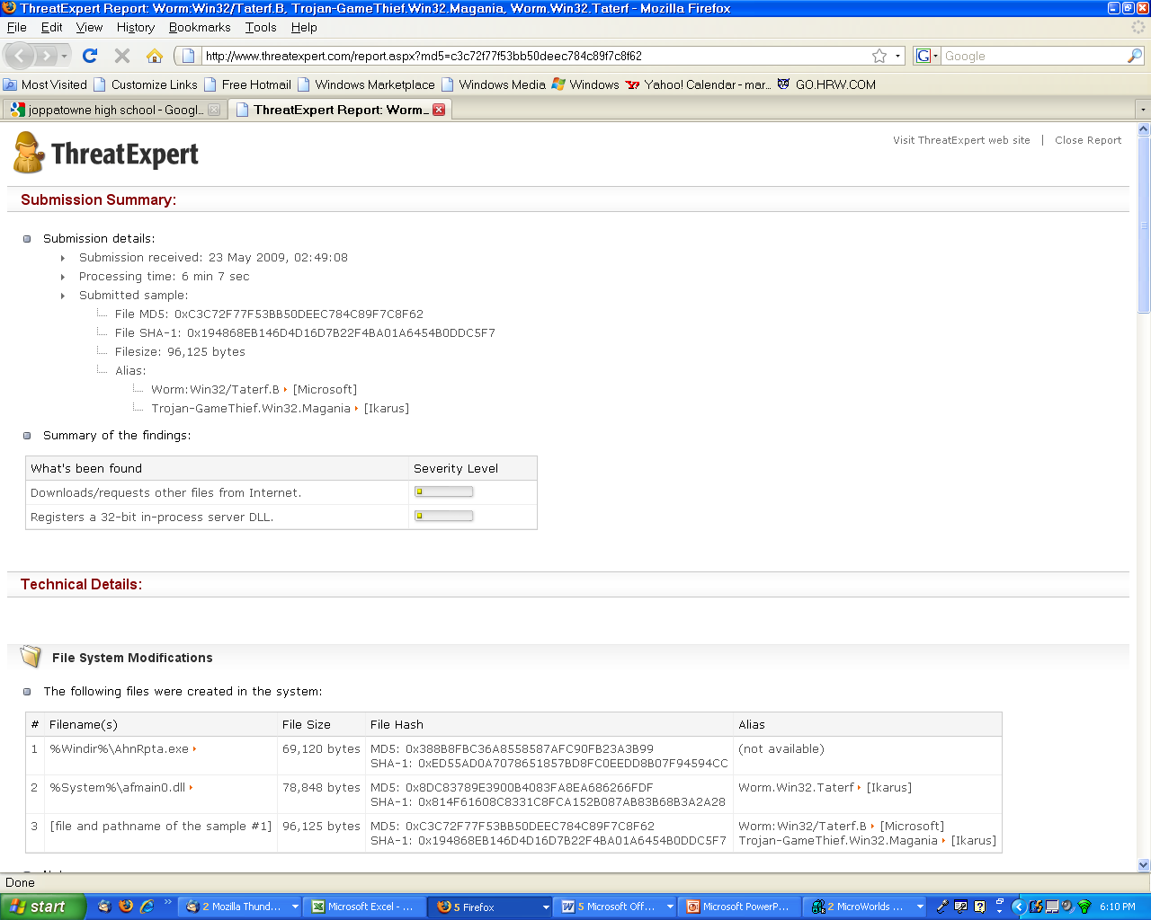

Slide 51
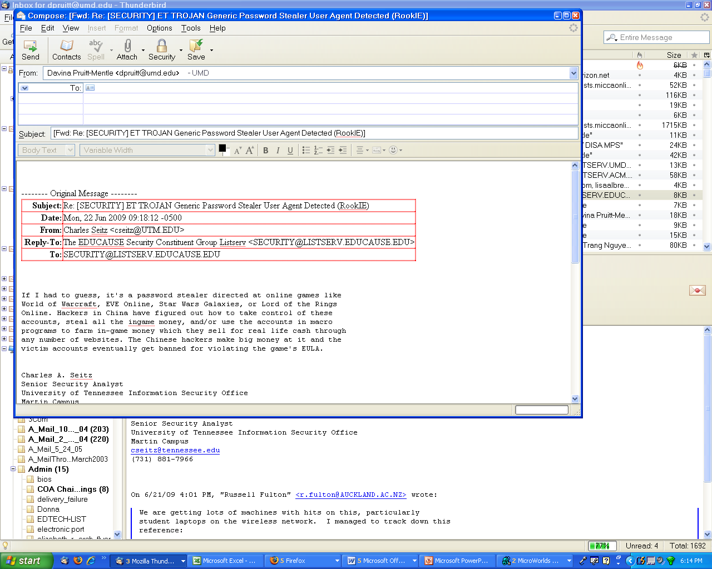
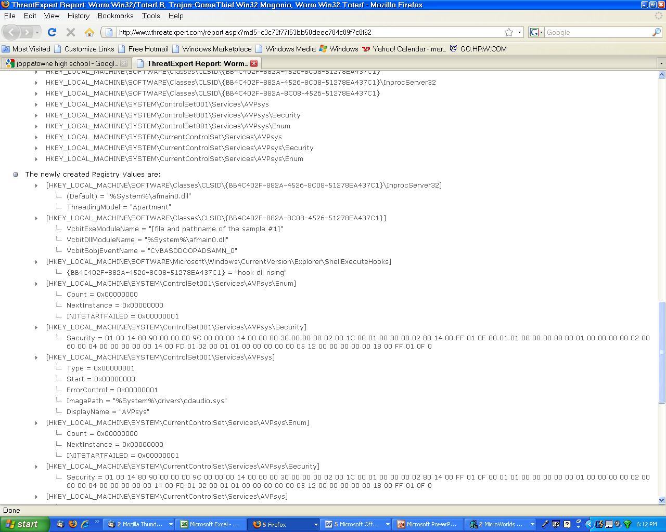

Slide 52
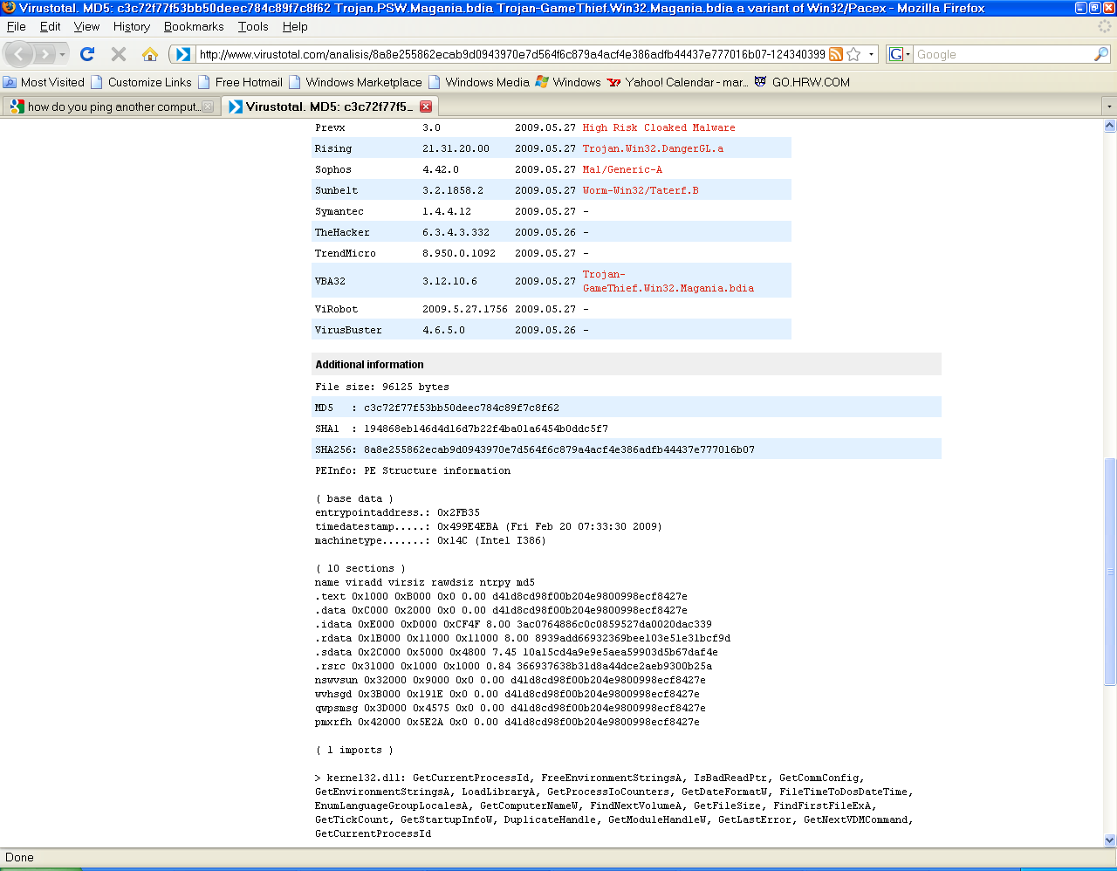

Slide 53
Team Challenges
Build a 3-5 page MW project around the theme Cybersecurity
  Game
  Story

Slide 55
What is IA?
CyberWATCH Video
  http://www.cyberwatchcenter.org/CyberWATCH/
Fox Video—Cyber challenge
Sneakers
  http://www.imdb.com/video/screenplay/vi2448753433/
The Net
  http://www.imdb.com/video/screenplay/vi2046230809/
Staying Safe Online: The Need for Cybersecurity
NATO Brief
Obama Need for Cybersecurity
National Collegiate Cyber Defense Competition
The Duhs of Security
Hacker
  http://www.youtube.com/watch?v=2efhrCxI4J0
NSA Commercial
  http://www.nsa.gov/careers/Media_Center/index.shtml

Slide 56
What is IA (cont)?
Theory and Practice of Cryptography
  http://www.youtube.com/watch?v=IzVCrSrZIX8
There May be a Shortage of Cybersecurity Professionals
  http://www.youtube.com/watch?v=MUPlMT2Mjyk
Lockheed Martin HOW Cyber Security
  http://www.youtube.com/watch?v=fhjFsWGcUm4&feature=related
Whoa, That's Awkward (EDUCAUSE WINNER)
  http://www.youtube.com/watch?v=gtSIDpoX0r0&feature=related
Northrop Grumman Battlespace Command
  http://www.youtube.com/watch?v=WsWW6HskcWg&feature=related
NSA spy techniques (good background--bias messaging)
  http://www.youtube.com/watch?v=48dRrNCjLus&feature=related
Lockheed Martin Security Intelligence Center
  http://www.youtube.com/watch?v=uSSBjpljvOA&feature=related
United States Air Force-Cyberspace Domain
  http://www.youtube.com/watch?v=xeWnZRZrpaY&feature=related

Slide 57
Other Videos
Robotics
Lockheed Martin HULC Exoskeleton
  http://www.youtube.com/watch?v=kat8I5UM_Vs&feature=related
Remove Cyber Security Removal Video
How to remove bad videos/bots
  http://www.youtube.com/watch?v=pM8bU0MHVEI&feature=related
Humorous October is cybersecurity awareness month--good example of what to do
Cyber Security Awareness - Missouri S&T
http://www.youtube.com/watch?v=XSMuaaWjnJ8&feature=related
CyberChallenge
  http://www.uscyberchallenge.org/

Slide 58
Careers in IS/IA & Digital Forensics
Handout for Labor Stats and Career Paths
http://www.careeronestop.org/

Slide 59
MicroWorlds
Introduction
LOGO programming language
  For History http://en.wikipedia.org/wiki/Logo_programming_language
  http://www.computernostalgia.net/articles/logo.htm
  http://en.wikipedia.org/wiki/Turtle_graphics
  http://www.codinghorror.com/blog/archives/001026.html
  Walking Randomly http://www.walkingrandomly.com/?p=13
Notes:
See also handouts in notebook

Slide 60
Other long list
    CyberWATCH.swf (good overview of the field and need for cybersecurity)
      http://www.cyberwatchcenter.org/CyberWATCH/
    LM_HOW_Cyber_Security.flv (cyber threats—espionage—likelihood and impact)
      http://www.youtube.com/watch?v=fhjFsWGcUm4&feature=related
    Lockheed_Martin_HULC_Exoskeleton.flv (wearable robots)
      http://www.youtube.com/watch?v=kat8I5UM_Vs&feature=related
    Lockheed_Martin_Security_Intelligence_Center.flv (connection with game/chess moves)
      http://www.youtube.com/watch?v=uSSBjpljvOA&feature=related
    NGC Battlespace_Command.flv (military flavor—Northrop Grumman)
      http://www.youtube.com/watch?v=WsWW6HskcWg&feature=related
    There_May_Be_A_Shortage_of_Cyber_Security_Professionals.flv (brief overview of jobs in cybersecurity)
      http://www.youtube.com/watch?v=MUPlMT2Mjyk
    NSA History (good history overview—some parts bias)
      http://www.youtube.com/watch?v=48dRrNCjLus&feature=related
    IWantToPlayWarcraftNow.flv
    Trailer for the movie The Net
      1995_-_The_Net_-_Trailer.flv
      1995_-_The_Net_-_Trailer.mp4
      http://www.imdb.com/video/screenplay/vi2046230809/
    NATOTrailer.flv (news brief)
    The_DUHS_Of_Security.wmv

Slide 61
Other long list
  Middle
    Any of the above plus….
    Are you protected? (iaav8_02.swf, iss3_02.swf, and iaav_08.swf)
    cyber_security_awareness_-_Missouri_S_amp_T.flv (student made awareness video RE malware/passwords etc…)
      http://www.youtube.com/watch?v=XSMuaaWjnJ8&feature=related
    United_States_Air_Force-Cyberspace_Domain.flv (explains cyberspace and how connects with cybersecurity—and the electromagnetic spectrum)
      http://www.youtube.com/watch?v=xeWnZRZrpaY&feature=related
    Trailer for the Movie Hackers
      Hackers_Movie_Trailer.flv (NOTE: stop before the last 2 seconds—bad language)
      http://www.youtube.com/watch?v=2efhrCxI4J0
    National_CCDC_2009.mov (promo for the National Collegiate Cyber Defense Competition)
      Other videos about Cyber Challenges http://www.uscyberchallenge.org/
      http://www.uscyberchallenge.org/media/video.cfm
    NSA_RecruitVideo_Small.wmv (NSA recruitment video)
      http://www.nsa.gov/careers/Media_Center/index.shtml
    StayingSafeOnlineTheNeedCybersecurity.mp4 (shows the muti dimensions of cybersecurity)

Slide 62
Other long list
  High
    Any of the above plus….
    How to remove fake malware scanning software Remove_Cyber_Security_Removal_Video.flv walk through step by step how to remove fake anti-malware software
      http://www.youtube.com/watch?v=pM8bU0MHVEI&feature=related
    Whoa_that_s_Awkward.flv EDUCAUSE WINNER VIDEO CONTEST(makes the connection with keeping anti virus up to date and not clicking on things not sure of—NOTE: does not show but references the connection with pornography and malware)
      http://www.youtube.com/watch?v=gtSIDpoX0r0&feature=related
    Trailer for the Movie Sneakers
      1992_-_Sneakers_-_Trailer.flv
      1992_-_Sneakers_-_Trailer.flv
      http://www.imdb.com/video/screenplay/vi2448753433/
    PresidentObamaCybersecurity.mp4 (Securing our Nations Cyber Infrastructure Speech)
    Theory_and_Practice_of_Cryptography.flv (Steve Weis Google Tech Talks—excellent overview)
      http://www.youtube.com/watch?v=IzVCrSrZIX8

